Slide 1
Constraint Satisfaction
Constraint Satisfaction
  The goal is to discover some problem state that satisfies a given set of constraints. E.g. Puzzles, real-world perceptual labeling problems, design tasks etc.
  Helps in reducing the amount of search required as compared with a method that attempts to form partial solutions directly by choosing specific values for components of the eventual solution.
  The fundamental issue is to include restrictions first that can be inferred from the rules of arithmetic. This reduces the number of guesses.
  The initial state contains the constraints that are originally given in the problem description.
  A goal state is any state that has been constrained enough, enough has to be defined for each problem.

Slide 2
Constraint Satisfaction
  It is a 2 step process.
    First, constraints are discovered and propagated as far as possible throughout the system.
    Then, if there is still no solution, search begins. A guess about something is made and added as a new constraint. Propagation can then occur with this new constraint and so forth.

Slide 3
Algorithm : Constraint Satisfaction
1. Propagate available constraints. To do this, first set OPEN to the set of all objects that must have values assigned to them in a complete solution. Then do until an inconsistency is detected or until OPEN is empty:
(a) Select an object OB from OPEN. Strengthen as much as possible the set of constraints that apply to OB.
(b) If this set is different from the set that was assigned the last time OB was examined or if this is the first time OB has been examined, then add to OPEN all objects that share any constraints with OB.
(c) Remove OB from OPEN.
2. If the union of the constraints discovered above defines a solution, then quit and report the solution.
3. If the union of the constraints discovered above defines a contradiction, then return failure.
4. If neither of the above occurs, then it is necessary to make a guess at something in order to proceed. To do this, loop until a solution is found or all possible solutions have been eliminated:
(a) Select an object whose value is not yet determined and select a way of strengthening the constraints on that object.
(b) Recursively invoke constraint satisfaction with the current set of constraints augmented by the strengthening constraint just selected.
66

Slide 4
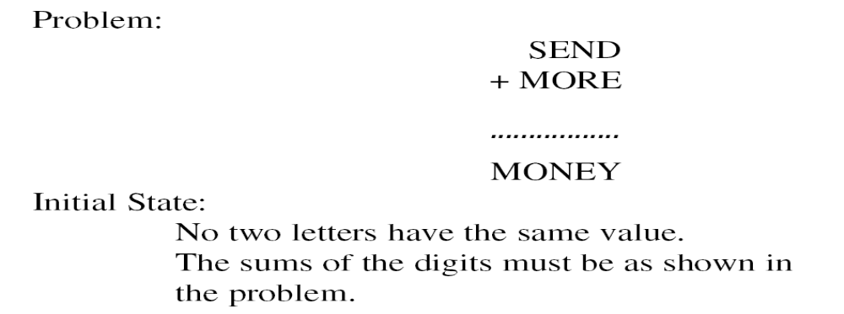
A Cryptarithmetic Problem
67

Slide 5
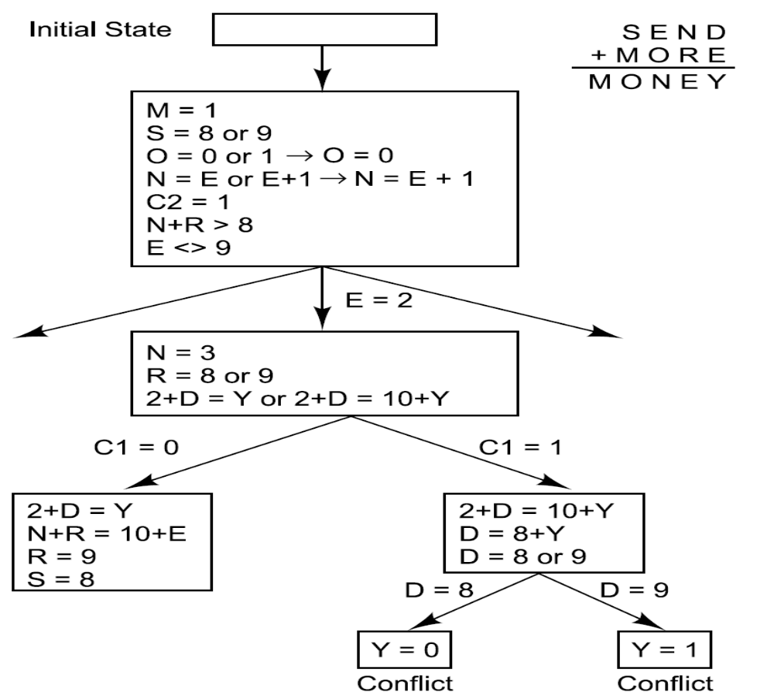
Solving a Cryptarithmetic Problem
68

Slide 6
From column 5, M = 1 since it is the only carry-over possible from the sum of two single digit numbers in column 4.
Since there is a carry in column 5, and M = 1, then O = 0
Since O = 0 there cannot be a carry in column 4 (otherwise N would also be 0 in column 3) so S = 9.
If there were no carry in column 3 then E = N, which is impossible. Therefore there is a carry and N = E + 1.
If there were no carry in column 2, then ( N + R ) mod 10 = E, and N = E + 1, so ( E + 1 + R ) mod 10 = E which means ( 1 + R ) mod 10 = 0, so R = 9. But S = 9, so there must be a carry in column 2 so R = 8.
To produce a carry in column 2, we must have D + E = 10 + Y.
Y is at least 2 so D + E is at least 12.
The only two pairs of available numbers that sum to at least 12 are (5,7) and (6,7) so either E = 7 or D = 7.
Since N = E + 1, E can't be 7 because then N = 8 = R so D = 7.
E can't be 6 because then N = 7 = D so E = 5 and N = 6.
D + E = 12 so Y = 2.

